Slide 1
Coronary Artery Disease
Gregory Pontone, M.D., MBA
Associate Medical Director of Ambulatory Quality and Physician Services

Slide 2
Introduction
Joined White Plains Hospital in March 2023
Internal Medicine Residency training at New York Hospital Cornell, Cardiology Fellowship at North shore University Hospital
Areas of interest include noninvasive cardiac imaging including transthoracic and trans esophageal echocardiogram, nuclear stress testing and lipid metabolism
Fellow of the American College of Cardiology

Slide 3
Coronary Artery Disease

Slide 4
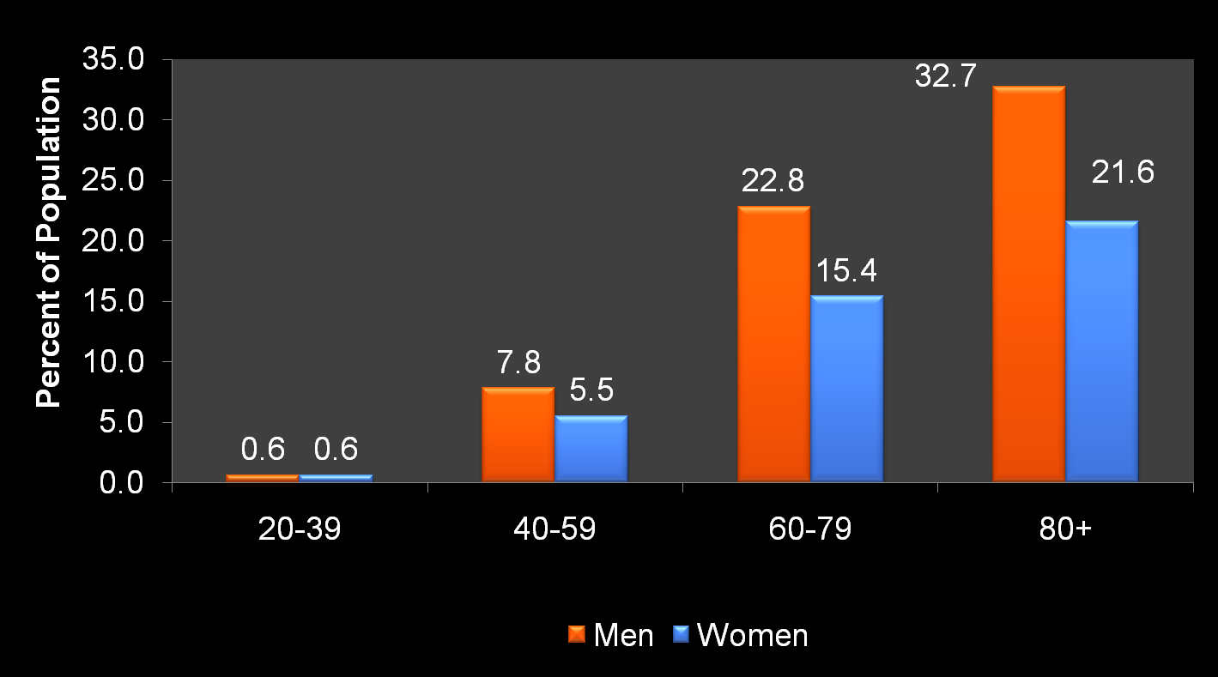
CAD- Prevalence
Coronary Artery Disease or CAD is one of the leading causes of mortality in the United States in men and women of every major ethnic group
Cardiovascular disease claims more lives each year than the next 4 leading causes of death combined

Slide 5
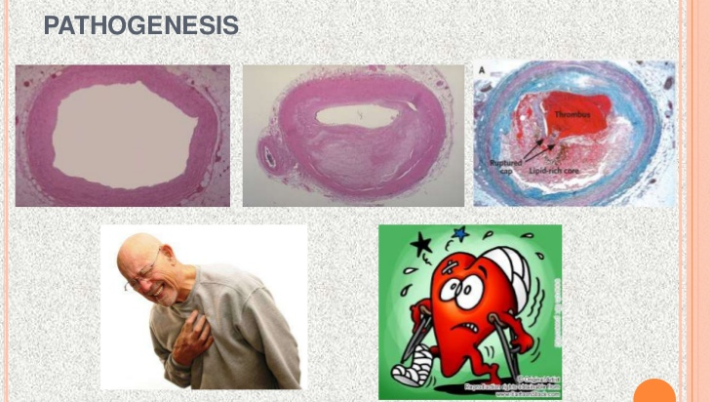
CAD- Plaque

Slide 6
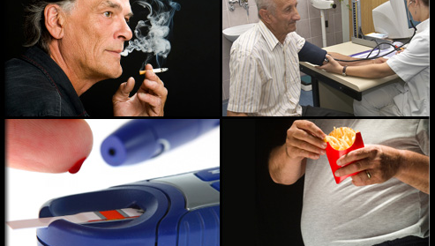
CAD- Who is at risk?

Slide 7
CAD- Known Risk Factors
Hypertension
Hyperlipidemia- high cholesterol
Smoking
Obesity
Sedentary lifestyle
Diabetes Mellitus
Family History of early onset CAD

Slide 8
CAD- Prevention
Exercise- Moderate exercise 30 min/day 4-5x/week
Healthy diet- low in sodium, cholesterol and saturated or Trans-fats. Omega-3 fatty acids and good fats found in fish, olive and peanut oils, almonds
Smoking cessation
Control sugars
Screening visit with PMD- blood work to obtain cholesterol levels, sugar, blood pressure checks and an EKG
Aspirin- Recent controversy

Slide 9
CAD- Cholesterol
The good, the bad and the ugly
HDL- high density or “good” cholesterol
LDL- low density or “bad” cholesterol
The ugly- VLDL, CRP, lipoprotein “a”
Traditional goals of keeping Total cholesterol less than 200, LDL less than 130 and HDL above 40
Triglycerides less than 150

Slide 10
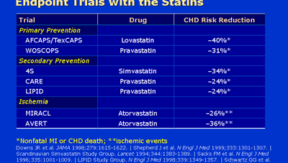
CAD- Statins

Slide 11
CAD- Signs and Symptoms
Findings may be normal during asymptomatic periods
Chest pain- due to lack of oxygen to heart muscle
Palpitations
Shortness of breath, decrease exercise tolerance
Syncope- passing out
Excessive fatigue

Slide 12
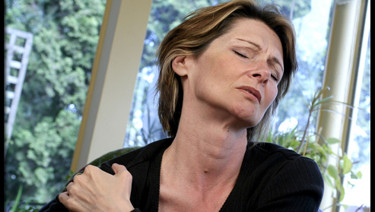
CAD- Atypical Presentations

Slide 13
CAD- Diagnosis
What your doctor can look for
History- detailed history pertaining to exertional symptoms, radiation and type of pain, precipitating factors, family history of premature cardiac disease
Physical Examination- heart murmurs, turbulent blood flow in arteries call bruits, peripheral vascular disease as a marker of CAD, xanthelasmas
Examination to rule out other causes of chest pain- musculoskeletal disorders, shingles, neuropathy, rib fracture, hiatal hernia

Slide 14
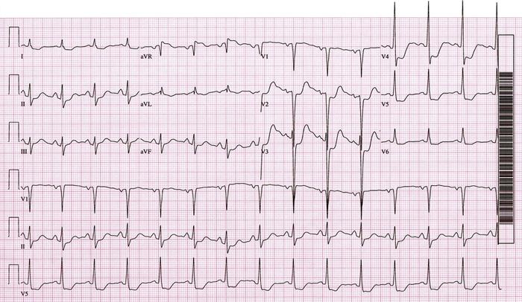
CAD- Electrocardiogram (EKG)

Slide 15
CAD- Stress Testing
Exercise EKG stress test
Cardiac Imaging stress test with Stress Echocardiogram and Nuclear stress test
Imaging adds about another 15% to overall sensitivity and specificity of stress test
Can be done with pharmacology if patient unable to walk on treadmill

Slide 16
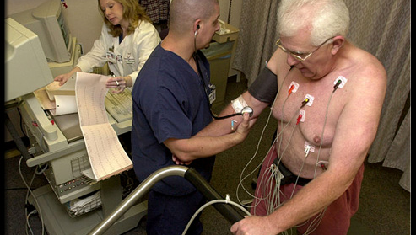
CAD- Treadmill Stress Test

Slide 17
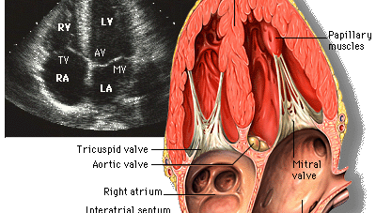
CAD- Echocardiogram

Slide 18
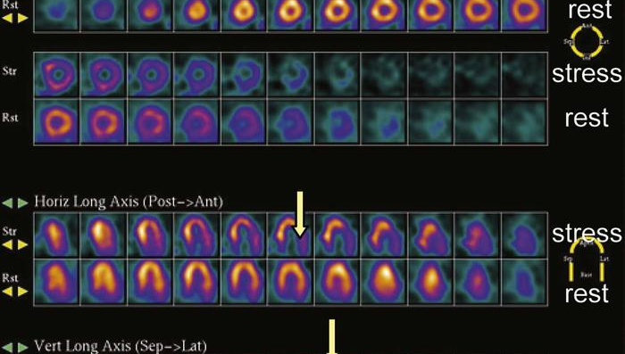
CAD- Nuclear Stress Testing

Slide 19
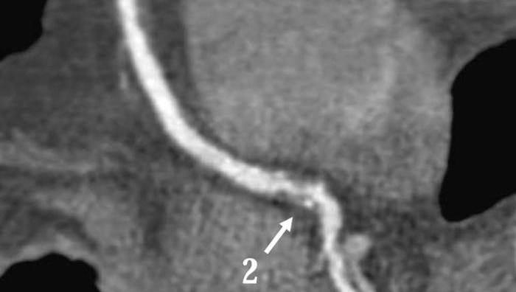
CAD- Coronary CT Imaging

Slide 20
CAD- Coronary Angiogram
Invasive procedure done in hospital in Cardiac Catheterization Laboratory
Access with a catheter for radial artery or femoral artery in leg
Catheter is placed up into the heart and under x-ray guidance, the coronary arteries are directly visualized with the injection of contrast
No general sedation, local anesthesia

Slide 21
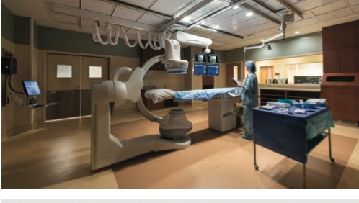
CAD- Angiogram

Slide 22
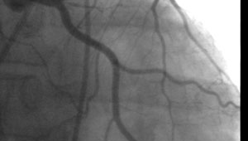
CAD- Coronary Anatomy

Slide 23
CAD- Medical Management
Lifestyle Modification- exercise, diet
Risk factor modification- control BP, Chol, Sugars
Pharmacologic treatment- ASA, Plavix, statins, Beta-blockers
Nitroglycerin

Slide 24
CAD- Surgical Revasculariztion
Percutaneous Transluminal Coronary Angioplasty
Same access technique as described with coronary angiogram
Can open a completely occluded artery in an acute myocardial infarction
Compress the plaque against the walls of the artery and dilate the vessel

Slide 25
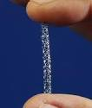
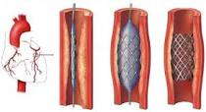
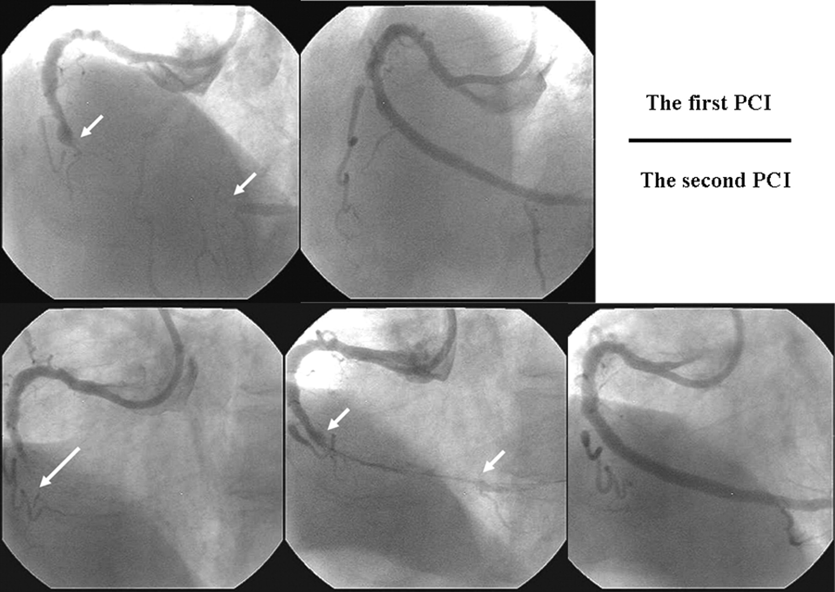
CAD- PTCA

Slide 26
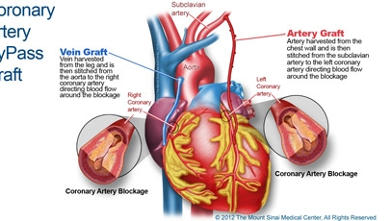
CAD- Coronary Bypass

Slide 27
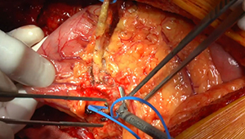
CAD- CABG

Slide 28
White Plains Hospital

Slide 29

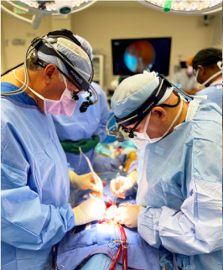
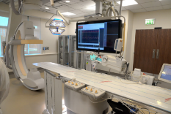
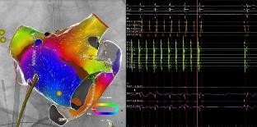
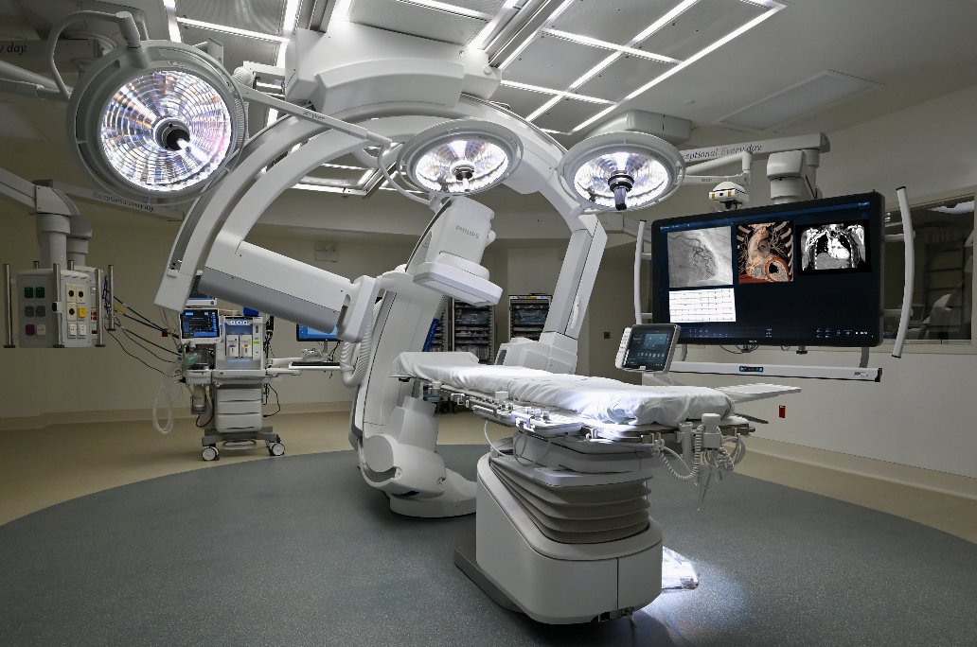
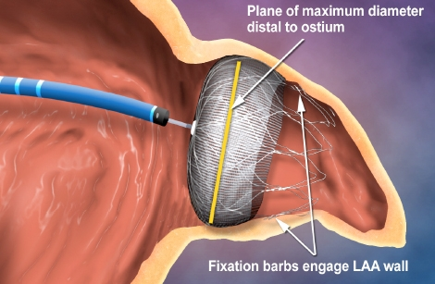
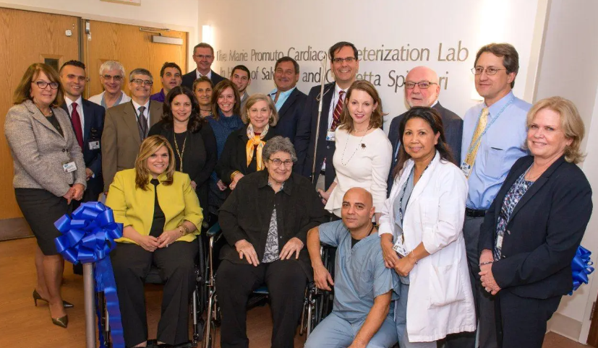
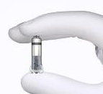
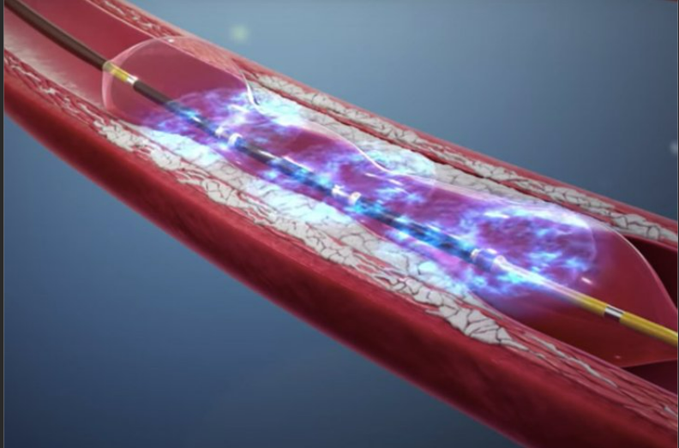

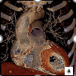
Timeline Highlights
2008
1st Cardiac Cath Lab Opens
2015
2nd Cardiac Cath Lab Opens
2018
EP Program Begins A.Flutter/SVT Catheter Ablations
2018
1st Micra Leadless PPM
2021
Open Heart Surgery and AF/VT Ablations
2021
Shockwave Intravascular Lithotripsy
2022
Hybrid OR opens
2022 New ICU Opens
2022
1st Watchman
2023 Advanced Cardiac Imaging

Slide 30
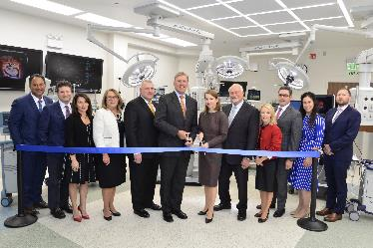
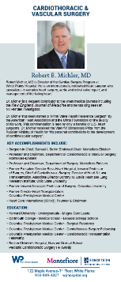
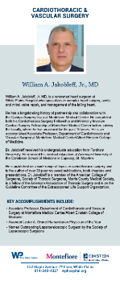
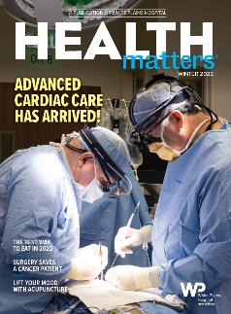
Cardiac Surgery – WPH

Slide 31

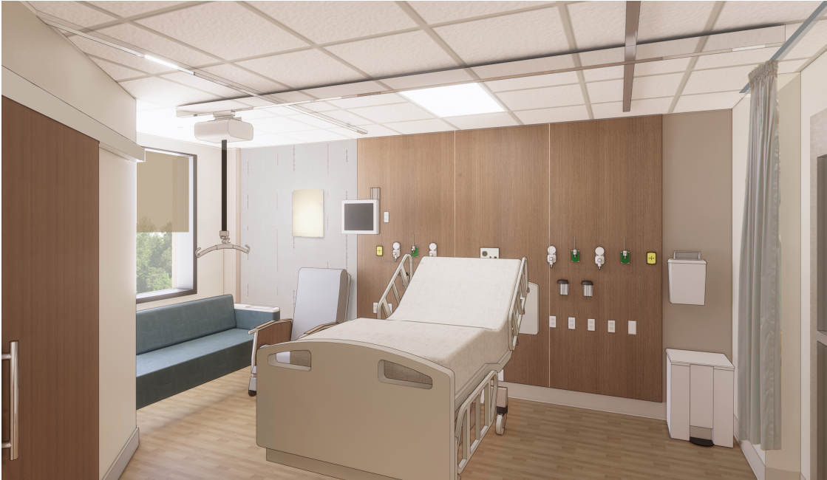
Cardiac Intensive Care

Slide 32

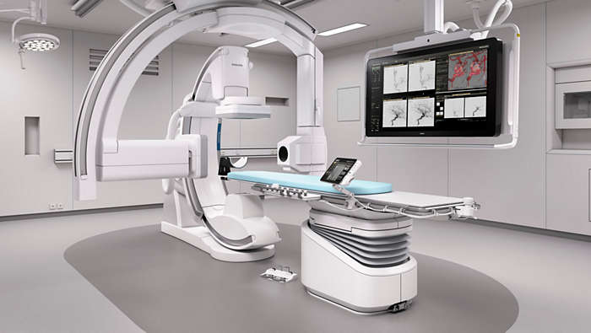
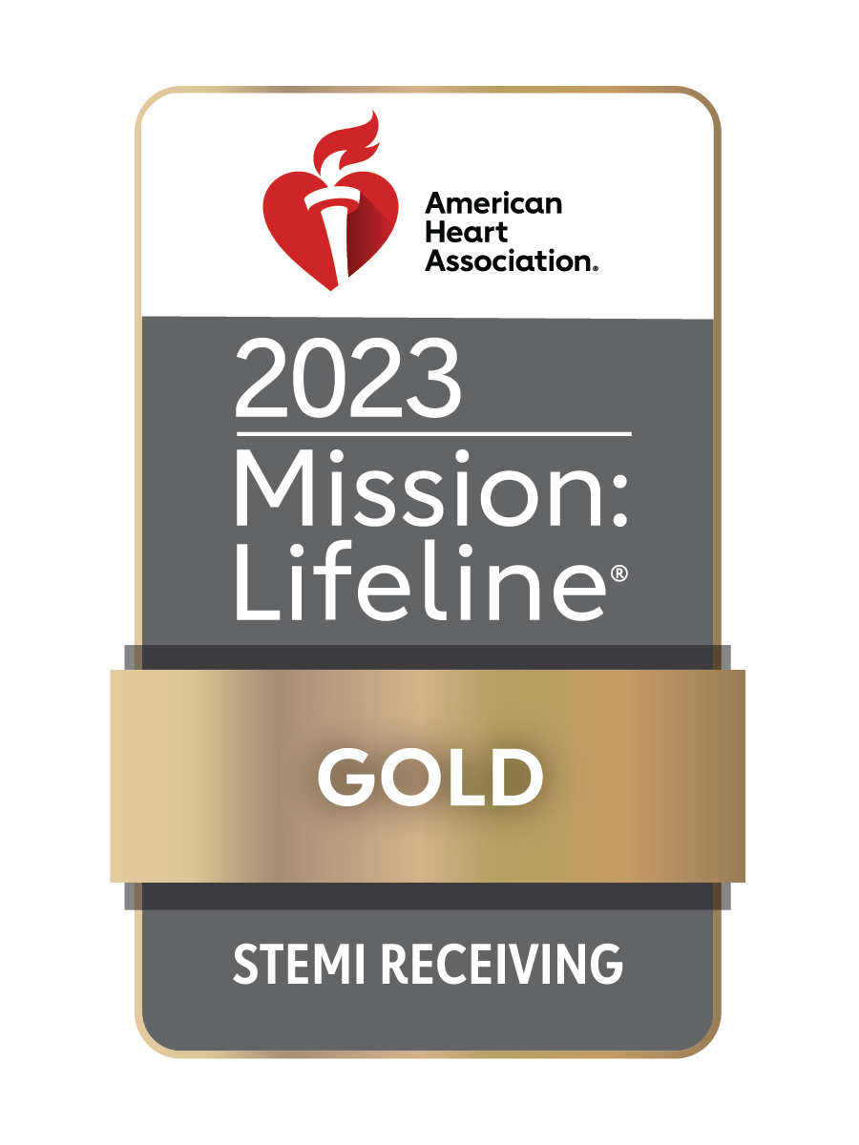
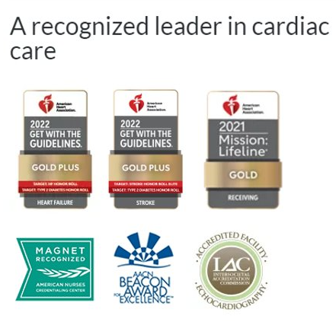
Accolades

Slide 33

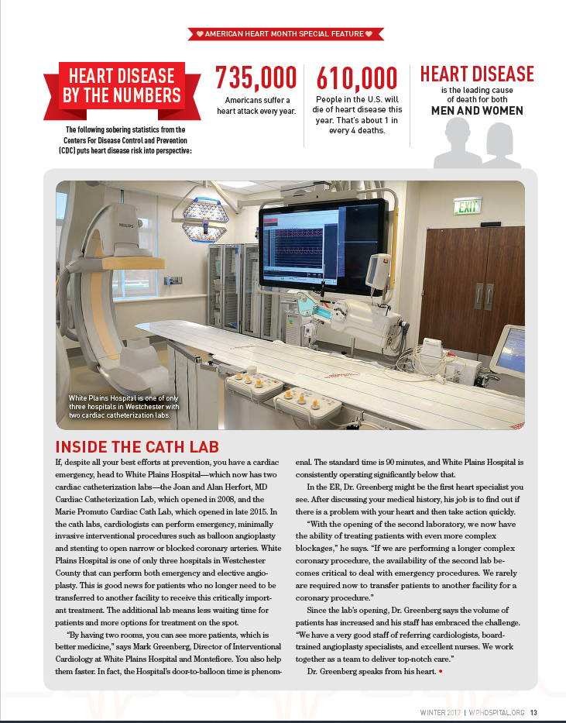
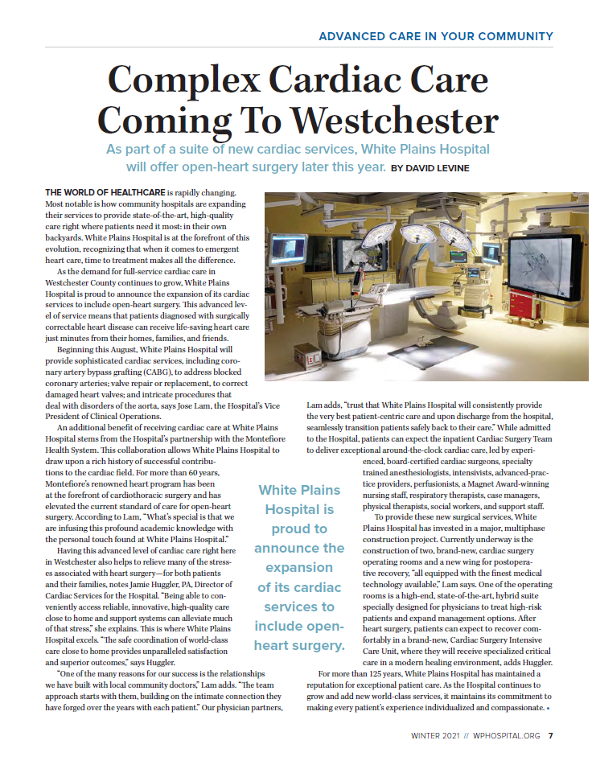
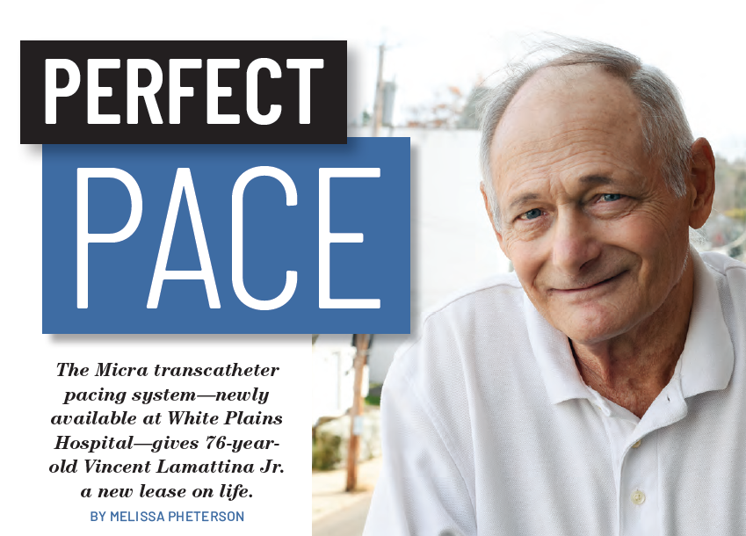
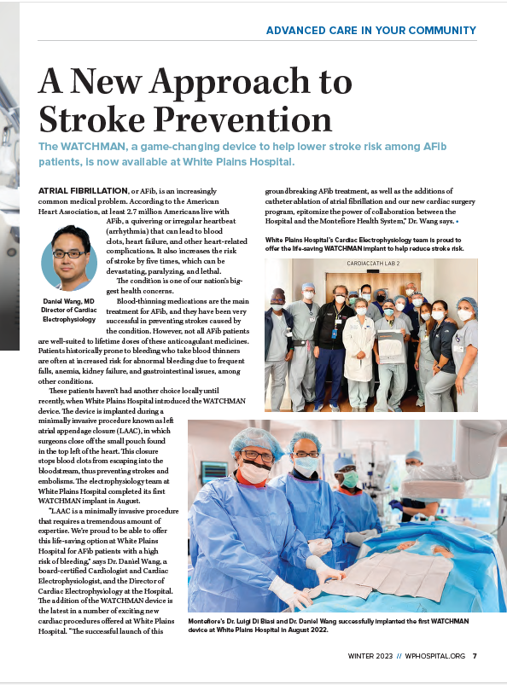
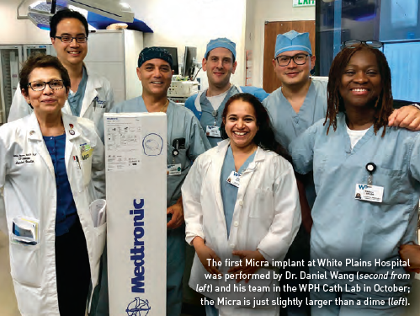

Health Matters Features
Feb 2023
Feb 2017
Feb 2021
Feb 2019

Slide 34
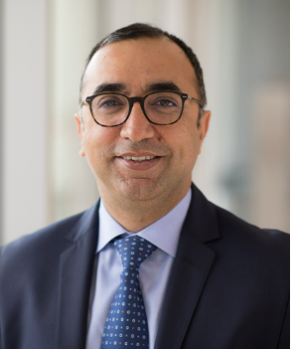
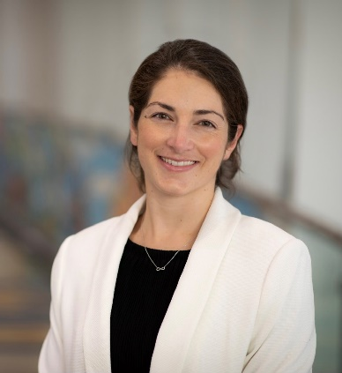
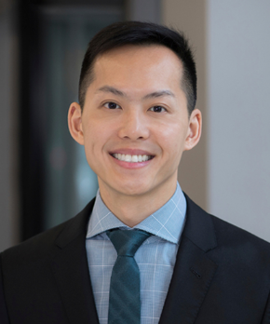
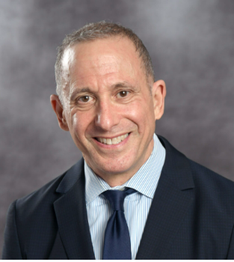
Structural Heart Team: Physician Leaders
M. Azeem Latib, MD
Section Head of MMC Interventional Cardiology
Interim, Chief of WPH Interventional Cardiology
Rachel Spallone, MD
Cardiothoracic Surgeon
Edwin C. Ho, MD
Co-Director
MMC Structural Heart Program
Douglas J. Hart, MD
Director
WPH Echocardiography Lab

Slide 35
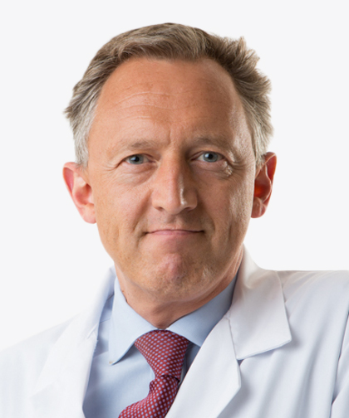
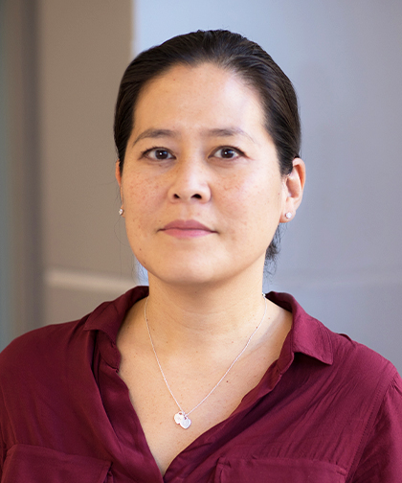

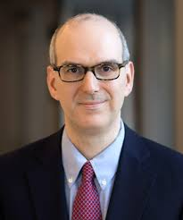
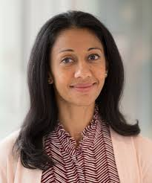
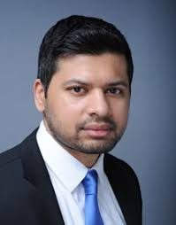
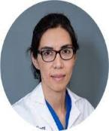
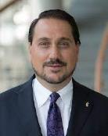



Faculty Section of Heart Failure
Ulrich Jorde, MD
HF Section Head
J. Julia Shin, MD
Fellowship Director
Snehal Patel, MD
Medical Director,
Heart Transplant
Danny Sims, MD
CCU Director
Sandhya Murthy, MD, Pulmonary Hypertension Dir
Omar Saeed, MD
Patricia Chavez, MD
Sasa Vukelic,
MD,PhD
Shivank Madan, MD
Yogita Rochlani, MD

Slide 36
Thank You

